Slide 1
The functioning of automatic stabilisers
Eurogroup
1 October 2018

Slide 2
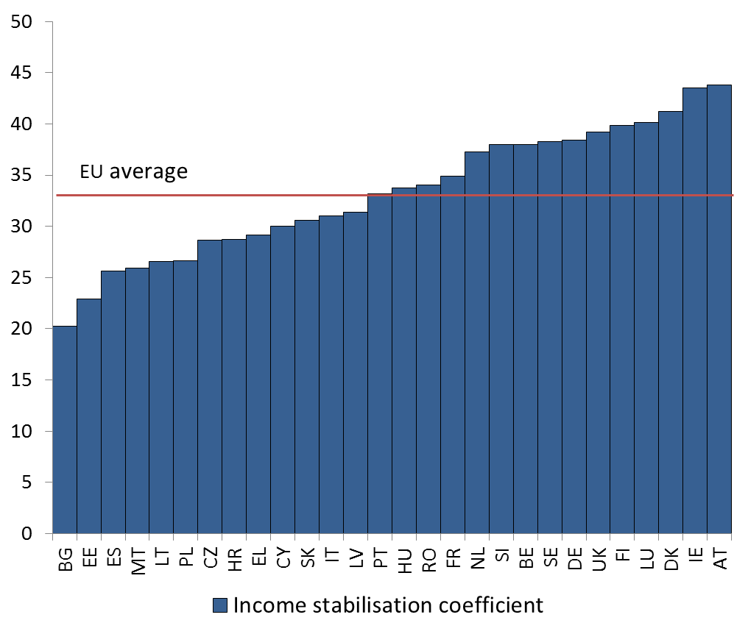
High income stabilisation, but large differences across countries
% of income
that is absorbed
Note: The income stabilisation coefficient measures the percentage share of disposable income, which is absorbed by a country’s tax and benefit system following an economic shock.
Source: European Commission (2017), Report on Public Finances in EMU, p. 103; joint work with JRC Seville.

Slide 3
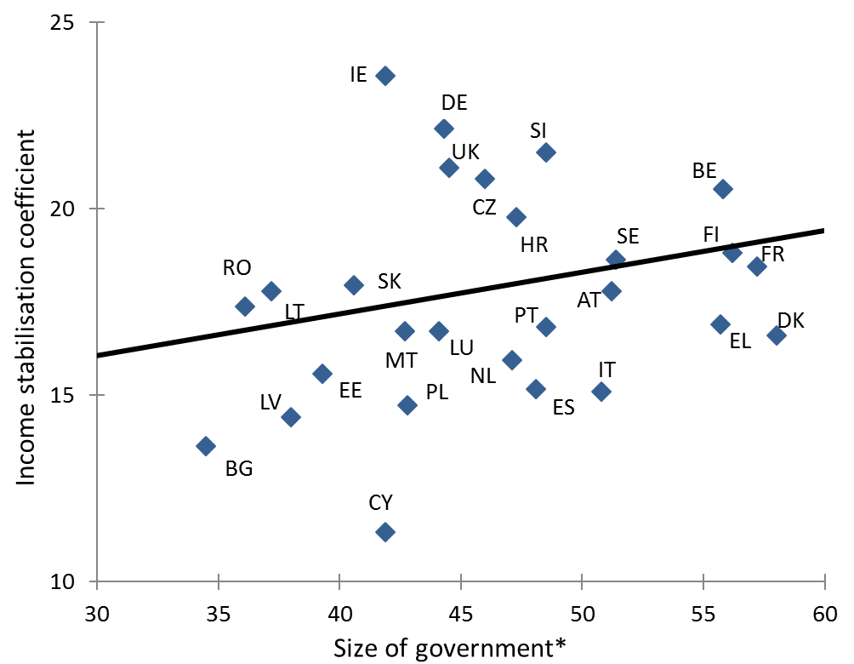
For a given size of the government automatic stabilisers could be enhanced
* Note: Size of government is measured by the expenditure to GDP ratio.
Source: Own illustration.

Slide 4
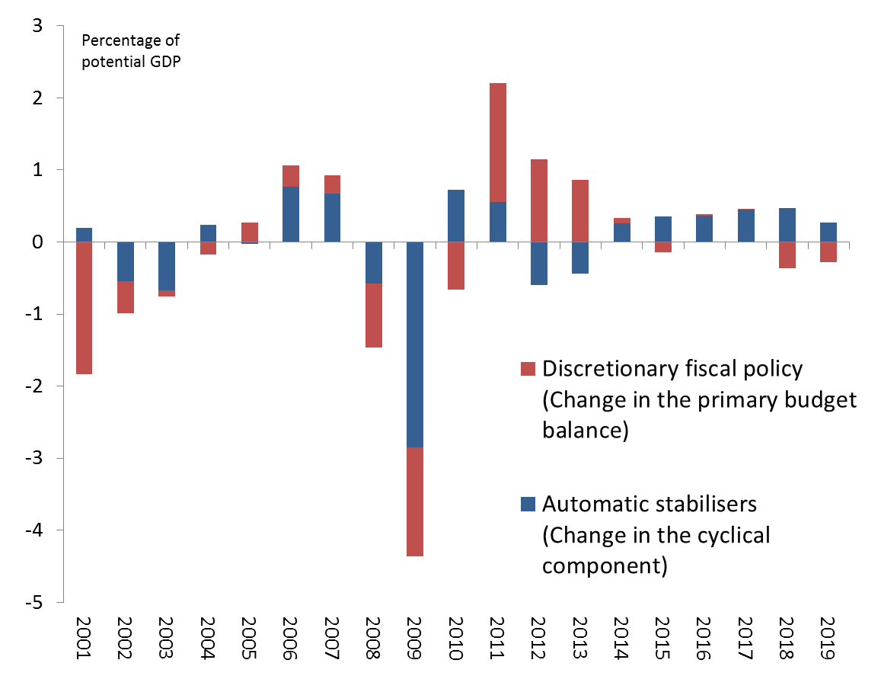
How can automatic stabilisers play freely?
Euro area
Source: European Commission 2018 spring forecast.

Slide 5
Thank you

